Slide 1

Analysis & Design of Information Systems
825200049 - AFINA PUTRI DAYANTI
825200050 - ERIC ANTHONY
825200008 - ALDI RESALDI MAULANA
PROGRAM STUDI SISTEM INFORMASI
UNIVERSITAS TARUMANAGARA

Slide 2
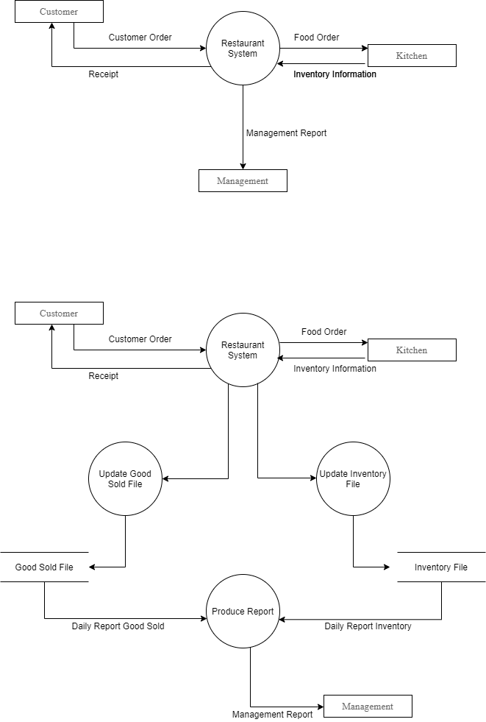
Diagram Context

Slide 3
DFD

Slide 4
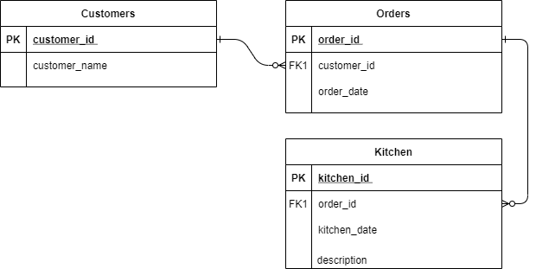
ERD

Slide 5
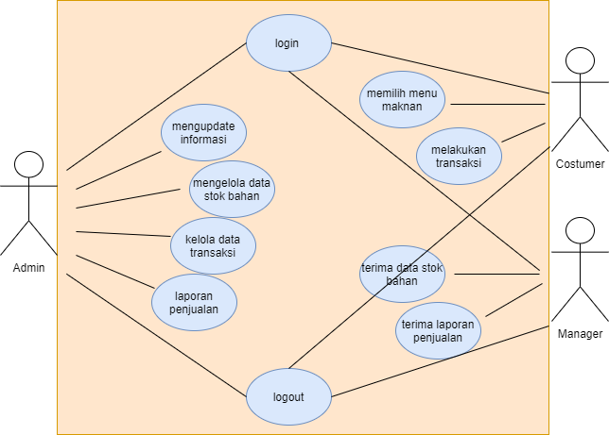
Use Case Diagram

